Slide 1


VECTOR MECHANICS FOR ENGINEERS
By: Fardinand P. Beer; E. Russell Johnston, Jr.; David F. Mazurek
ENGINEERING 3120
STATICS
CHAPTER 7
FORCES IN
BEAMS AND CABLES
Slides revised by:
A.A. KHANDKER, Ph.D., P.E
Copyright: McGraw Hill Education

Slide 2
FORCES IN BEAMS AND CABLES - TOPICS IN CHAPTER 7
Introduction
Internal Forces in Members
Sample Problem 7.1
Various Types of Beam Loading and Support
Shear and Bending Moment in a Beam
Sample Problem 7.2
Sample Problem 7.3
Relations Among Load, Shear, and Bending Moment
Sample Problem 7.4
Sample Problem 7.6
Cables With Concentrated Loads
Cables With Distributed Loads
Parabolic Cable
Sample Problem 7.8
Catenary

Slide 3

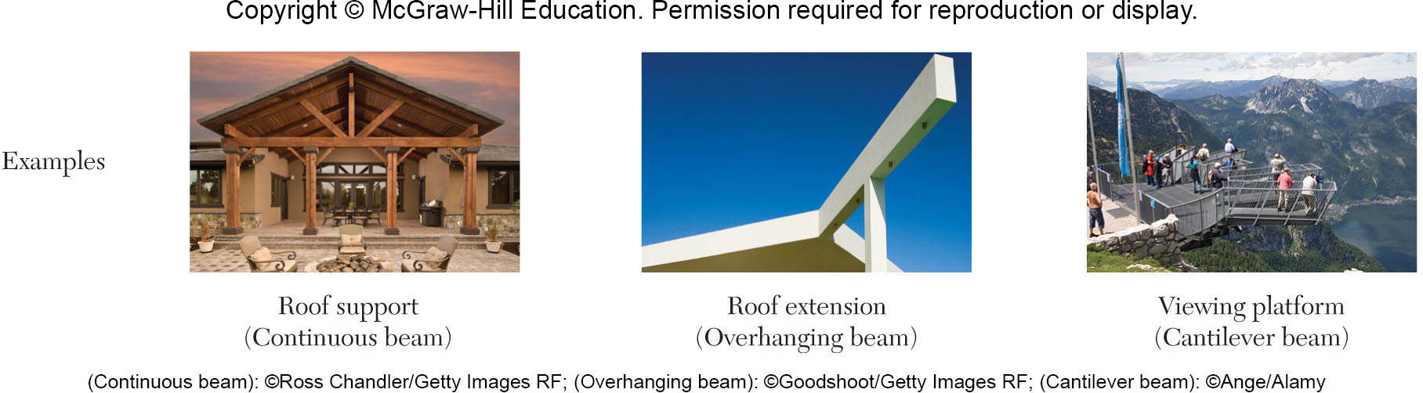
INTERNAL FORCES IN BEAMS AND CABLES
The current chapter is concerned with determining the internal forces (i.e., tension/compression, shear, and bending) which hold together the various parts of a given member.
Focus is on two important types of engineering structures:
Beams - usually long, straight, prismatic members designed to support loads applied at various points along the member.
Cables - flexible members capable of withstanding only tension, designed to support concentrated or distributed loads.

Slide 4
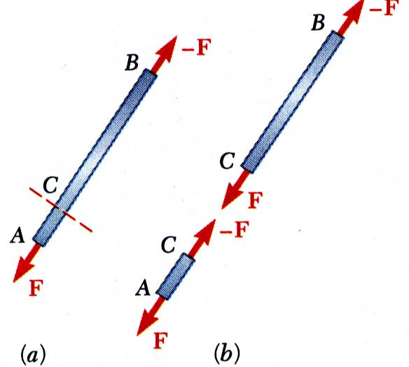
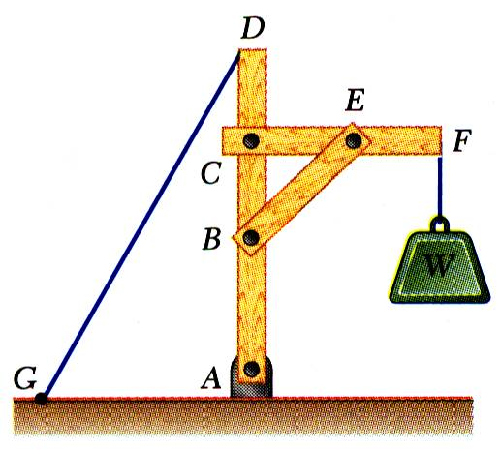
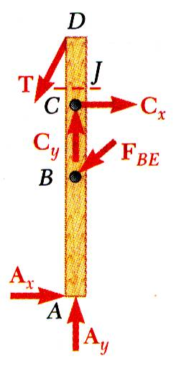
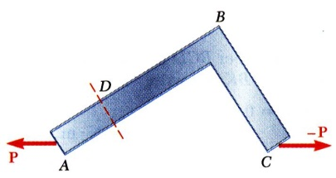
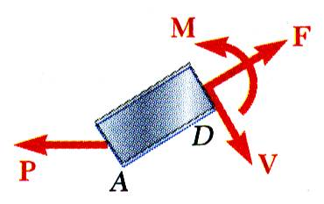
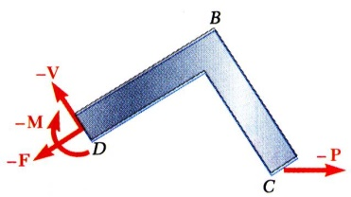
INTERNAL FORCES IN MEMBERS
Straight two-force member AB is in equilibrium under application of F and -F.
Internal forces equivalent to F and -F are required for equilibrium of free-bodies AC and CB.
Multi-force member ABCD is in equilibrium under application of cable and member contact forces.
Internal forces equivalent to a force-couple system are necessary for equilibrium of free-bodies JD and ABCJ.
An internal force-couple system is required for equilibrium of two-force members which are not straight.

Slide 5
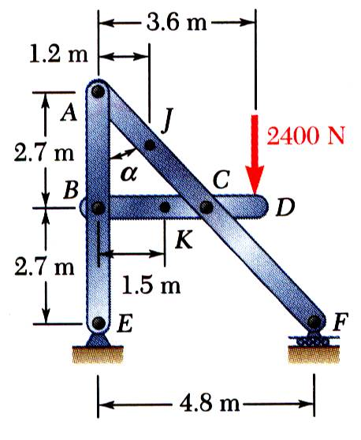
EXAMPLE PROBLEM 7.1
STRATEGY:
Compute reactions and forces at connections for each member.
Cut member ACF at J. The internal forces at J are represented by equivalent force-couple system which is determined by considering equilibrium of either part
Cut member BCD at K. Determine force-couple system equivalent to internal forces at K by applying equilibrium conditions to either part.
Determine the internal forces (a) in member ACF at point J and (b) in member BCD at K.

Slide 6
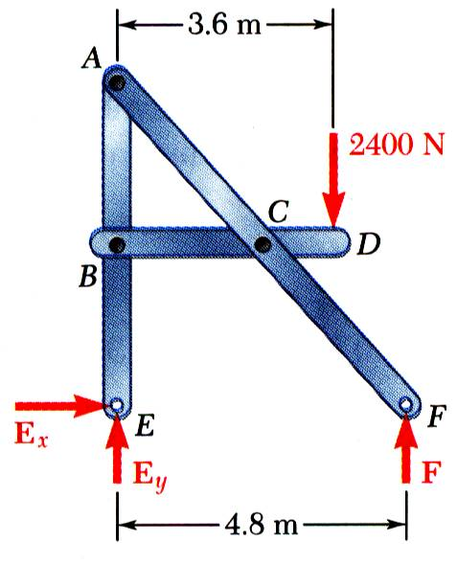
EXAMPLE PROBLEM 7.1 - SOLUTION
MODELING:
Compute reactions and connection forces.
Consider entire frame as a free-body:
ANALYSIS:

Slide 7
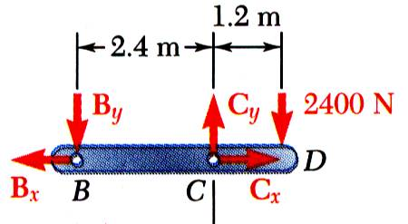
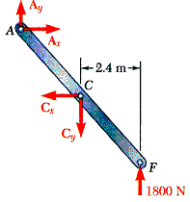
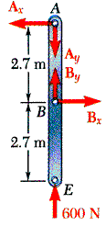
EXAMPLE PROBLEM 7.1 - SOLUTION
Consider member BCD as free-body:
Consider member ABE as free-body:
From member BCD,

Slide 8
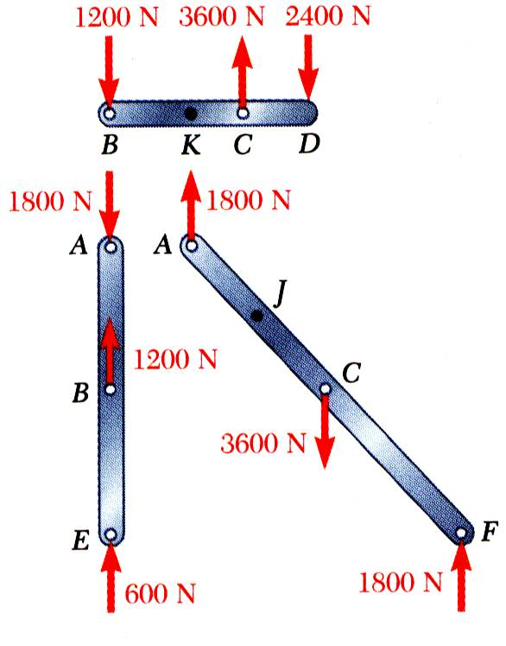
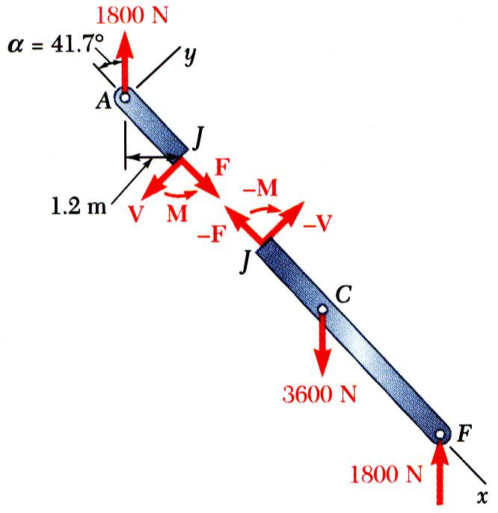
EXAMPLE PROBLEM 7.1 SOLUTION (continued)
Cut member ACF at J. The internal forces at J are represented by equivalent force-couple system.
Consider free-body AJ:

Slide 9
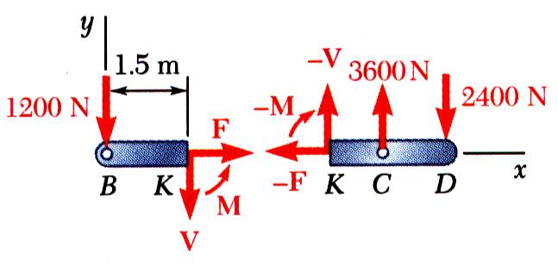
EXAMPLE PROBLEM 7.1 – SOLUTION (continued)
Cut member BCD at K. Determine a force-couple system equivalent to internal forces at K.
Consider free-body BK:
REFLECT and THINK:
We are now determining the internal forces and moments within a structural member. These are of central importance in the study of mechanics of materials.

Slide 10
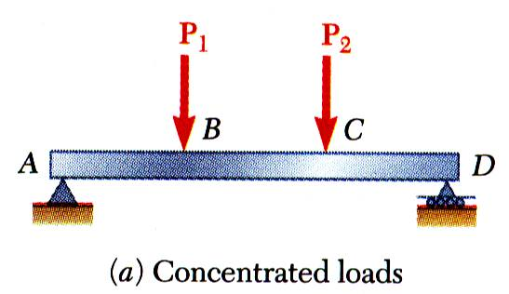
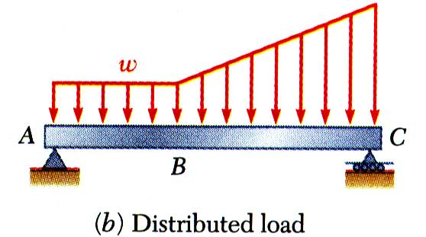
VARIOUS TYPES OF BEAM LOADING AND SUPPORT
Beam - structural member designed to support loads applied at various points along its length.
Beam can be subjected to concentrated loads or distributed loads or combination of both
Beam design is two-step process:
determine shearing forces and bending moments produced by applied loads
select cross-section best suited to resist shearing forces and bending moments

Slide 11
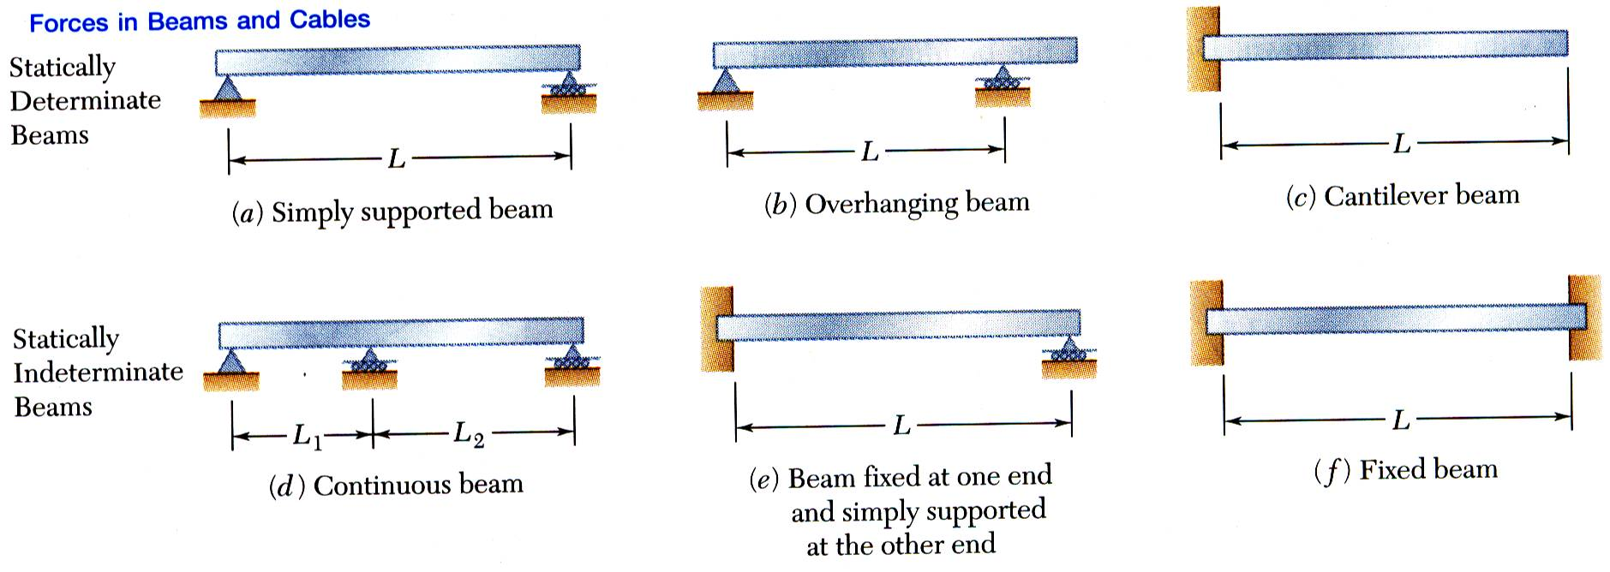
VARIOUS TYPES OF BEAM LOADING AND SUPPORT
Beams are classified according to way in which they are supported.
Reactions at beam supports are determinate if they involve only three unknowns. Otherwise, they are statically indeterminate.

Slide 12
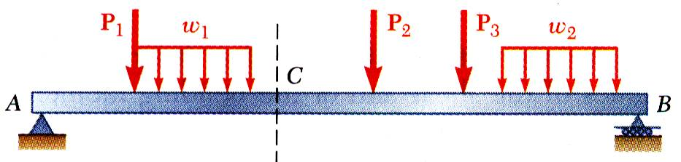
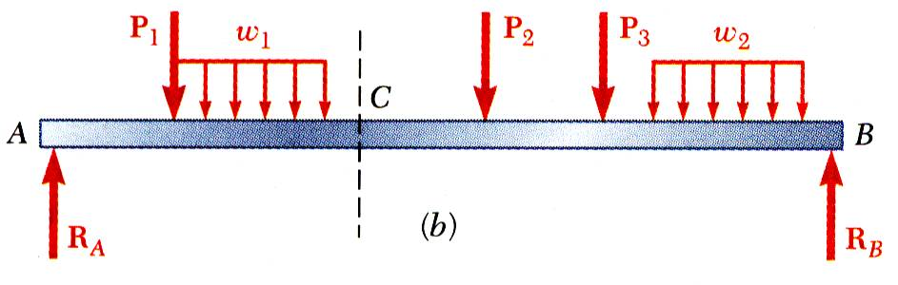
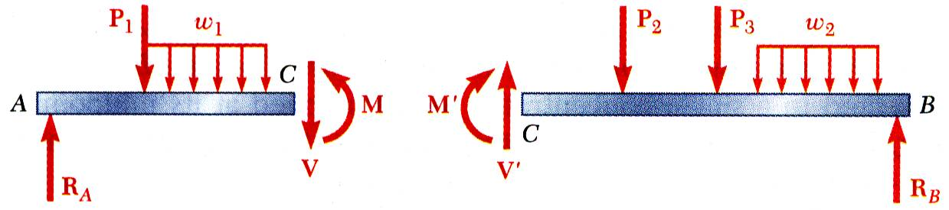
SHEAR AND BENDING MOMENT IN A BEAM
Wish to determine bending moment and shearing force at any point in a beam subjected to concentrated and distributed loads.
Determine reactions at supports by treating whole beam as free-body.
Cut beam at C and draw free-body diagrams for AC and CB. By definition, positive sense for internal force-couple systems are as shown.
From equilibrium considerations, determine M and V or M’ and V’.

Slide 13
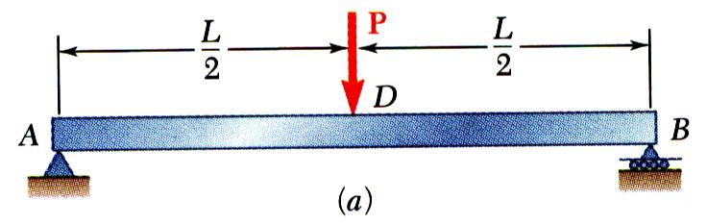
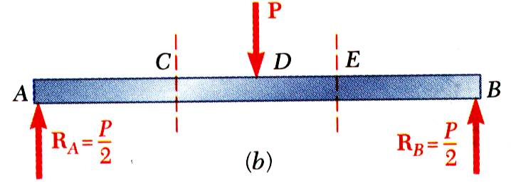
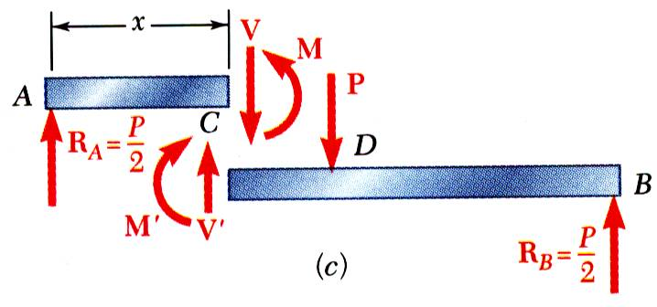
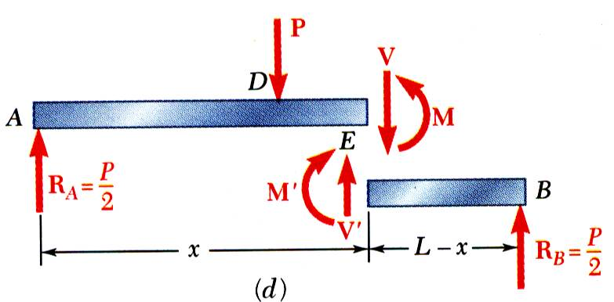
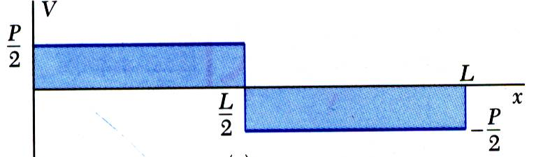
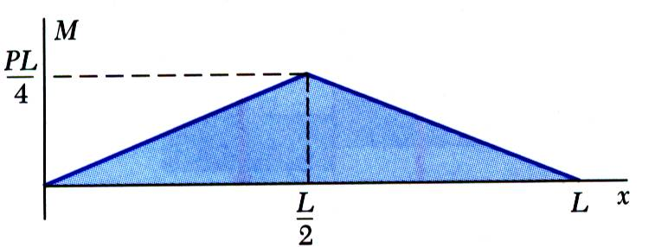
SHEAR AND BENDING MOMENT DIAGRAMS
Variation of shear and bending moment along beam may be plotted.
Determine reactions at supports.
Cut beam at C and consider member AC,
Cut beam at E and consider member EB,
For a beam subjected to concentrated loads, shear is constant between loading
For a beam subjected to concentrated loads, moment varies linearly.

Slide 14
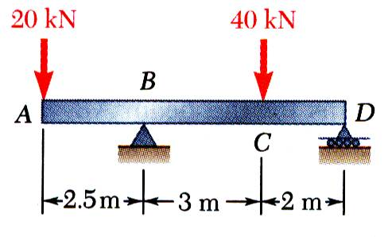
EXAMPLE PROBLEM 7.2
STRATEGY:
Taking entire beam as a free-body, calculate reactions at B and D.
Find equivalent internal force-couple systems for free-bodies formed by cutting beam on either side of load application points.
Plot results.
Draw the shear and bending moment diagrams for the beam and loading shown.

Slide 15
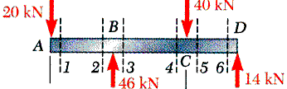
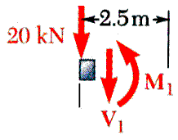
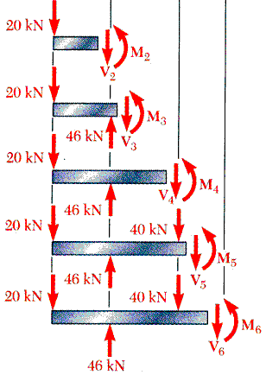
EXAMPLE PROBLEM 7.2 - SOLUTION
Taking entire beam as a free-body, calculate reactions at B and D.
Find equivalent internal force-couple systems at sections on either side of load application points.
Similarly,

Slide 16
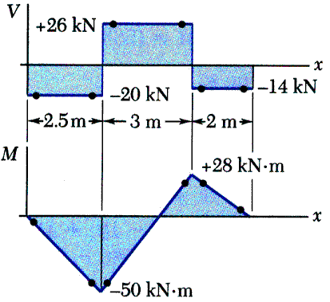
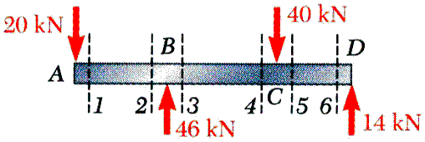
EXAMPLE PROBLEM 7.2 – SOLUTION (continued)
Plot results.
Note that shear is of constant value between concentrated loads and bending moment varies linearly
REFLECT and THINK:
The calculations are similar for each new choice of free body. However, moving along the beam, the shear changes magnitude whenever you pass a transverse force and the graph of the bending moment changes slope at these points.

Slide 17
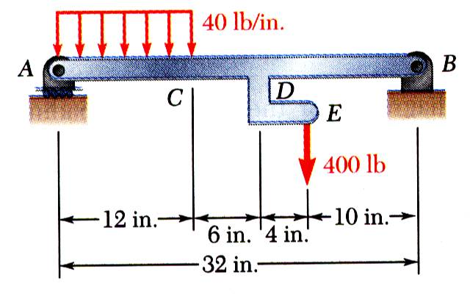
EXAMPLE PROBLEM 7.3
STRATEGY:
Taking entire beam as free-body, calculate reactions at A and B.
Determine equivalent internal force-couple systems at sections cut within segments AC, CD, and DB.
Plot results.
Draw the shear and bending moment diagrams for the beam AB. The distributed load of 40 lb/in. extends over 12 in. of the beam, from A to C, and the 400 lb load is applied at E.

Slide 18
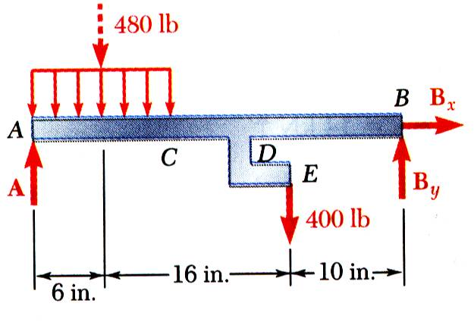
EXAMPLE PROBLEM 7.3 - SOLUTION
MODELING and ANALYSIS:
Taking entire beam as a free-body, calculate reactions at A and B.
Note: The 400 lb load at E may be replaced by a 400 lb force and 1600 lb-in. couple at D.

Slide 19
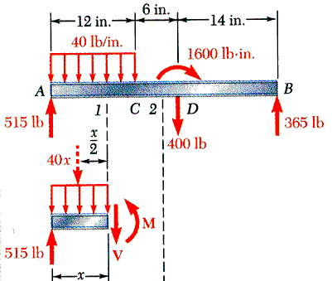
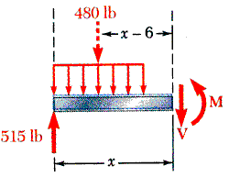
EXAMPLE PROBLEM 7.3 – SOLUTION (continued)
Evaluate equivalent internal force-couple systems at sections cut within segments AC, CD, and DB.
From A to C:
From C to D:

Slide 20
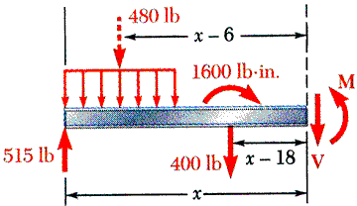
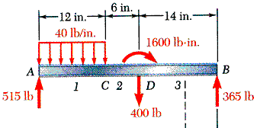
EXAMPLE PROBLEM 7.3 – SOLUTION (continued)
Evaluate equivalent internal force-couple systems at sections cut within segments AC, CD, and DB.
From D to B:

Slide 21
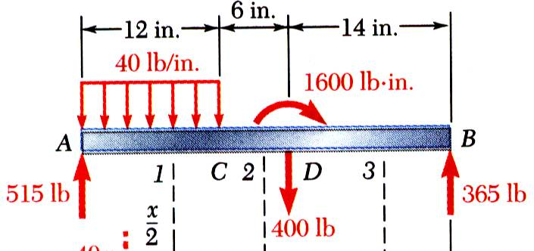
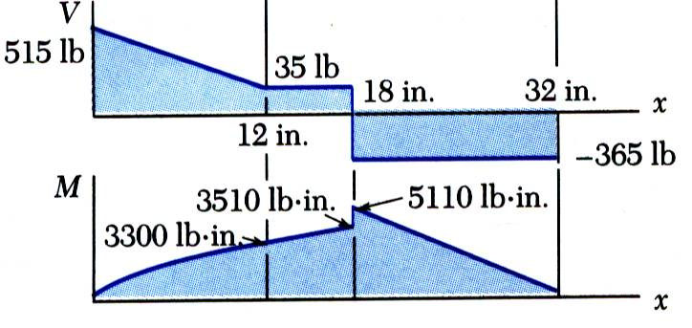
EXAMPLE PROBLEM 7.3 – SOLUTION (continued)
Plot results.
From A to C:
From C to D:
From D to B:
REFLECT and THINK:
Shear and bending-moment diagrams typically feature various kinds of curves and discontinuities. In such cases, it is often useful to express V and M as functions of location x as well as to determine certain numerical values.

Slide 22
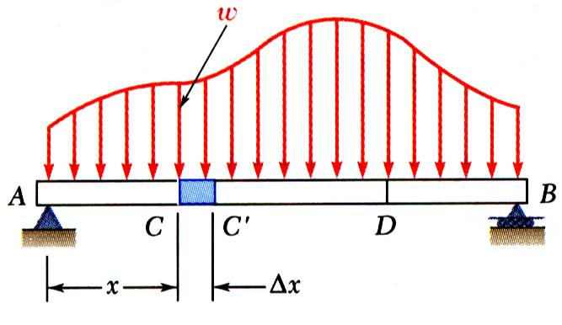
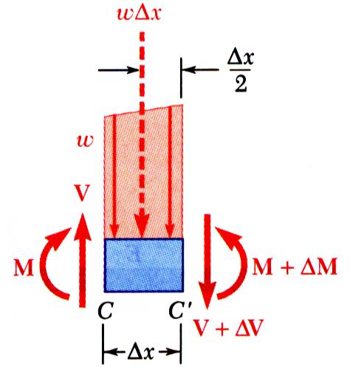
RELATIONS AMONG LOAD, SHEAR AND BENDING MOMENT
Relations between load and shear:
Relations between shear and bending moment:

Slide 23
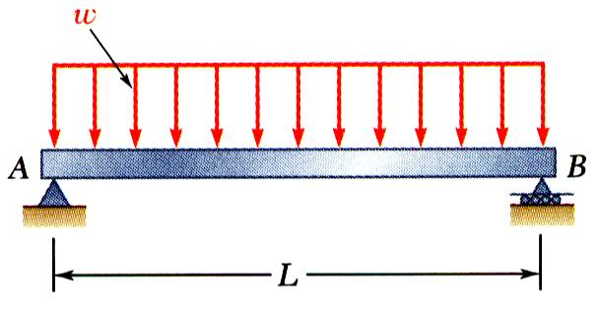
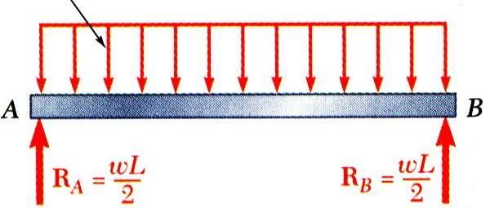
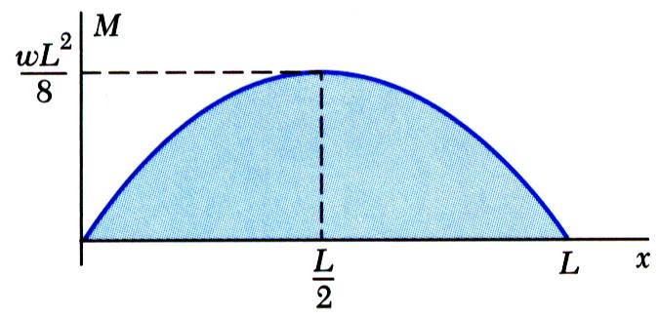
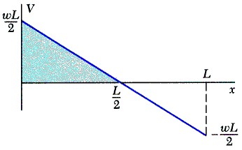
RELATIONS AMONG LOAD, SHEAR AND BENDING MOMENT
Reactions at supports,
Shear curve,
Moment curve,

Slide 24
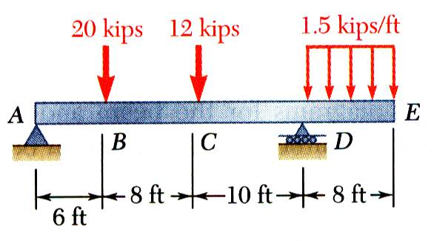
EXAMPLE PROBLEM 7.4
STRATEGY:
Taking entire beam as a free-body, determine reactions at supports.
Between concentrated load application points, and shear is constant.
With uniform loading between D and E, the shear variation is linear.
Between concentrated load application points, The change in moment between load application points is equal to area under shear curve between points.
With a linear shear variation between D and E, the bending moment diagram is a parabola.
Draw the shear and bending-moment diagrams for the beam and loading shown.

Slide 25
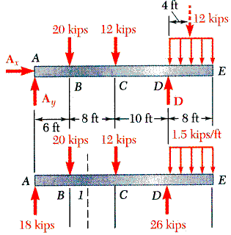
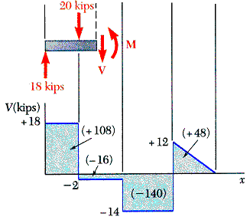
EXAMPLE PROBLEM 7.4 - SOLUTION
MODELING and ANALYSIS:
Taking entire beam as a free-body, determine reactions at supports.
Between concentrated load application points, and shear is constant.
With uniform loading between D and E, the shear variation is linear.

Slide 26


EXAMPLE PROBLEM 7.4 – SOLUTION (continued)
Between concentrated load application points,
The change in moment between load application points is equal to area under the shear curve between points.
With a linear shear variation between D and E, the bending moment diagram is a parabola.
REFLECT and THINK:
As expected, the values of shear and slopes of the bending-moment curves show abrupt changes at the points where concentrated loads act. Useful for design, these diagrams make it easier to determine the maximum values of shear and bending moment for a beam and its loading.

Slide 27

EXAMPLE PROBLEM 7.6
STRATEGY:
The change in shear between A and B is equal to the negative of area under load curve between points. The linear load curve results in a parabolic shear curve.
With zero load, change in shear between B and C is zero.
The change in moment between A and B is equal to area under shear curve between points. The parabolic shear curve results in a cubic moment curve.
The change in moment between B and C is equal to area under shear curve between points. The constant shear curve results in a linear moment curve.
Sketch the shear and bending-moment diagrams for the cantilever beam and loading shown.

Slide 28

EXAMPLE PROBLEM 7.6 - SOLUTION
MODELING and ANALYSIS:
The change in shear between A and B is equal to negative of area under load curve between points. The linear load curve results in a parabolic shear curve.
With zero load, change in shear between B and C is zero.

Slide 29

EXAMPLE PROBLEM 7.6 – SOLUTION (continued)
The change in moment between A and B is equal to area under shear curve between the points. The parabolic shear curve results in a cubic moment curve.
The change in moment between B and C is equal to area under shear curve between points. The constant shear curve results in a linear moment curve.

Slide 30

CABLES WITH CONCENTRATED LOADS
For analysis, assume:
concentrated vertical loads on given vertical lines,
weight of cable is negligible,
cable is flexible, i.e., resistance to bending is small,
portions of cable between successive loads may be treated as two force members
Wish to determine shape of cable, i.e., vertical distance from support A to each load point.
REFLECT and THINK:
Although not strictly required for the solution of this problem, determining the support reactions would serve as an
excellent check of the final values of the shear and bending-moment diagrams.
Cables are applied as structural elements in suspension bridges, transmission lines, aerial tramways, guy wires for high towers, etc.

Slide 31
CABLES WITH CONCENTRATED LOADS
Cables are applied as structural elements in suspension bridges, transmission lines, aerial tramways, guy wires for high towers, etc.
For analysis, assume:
concentrated vertical loads on given vertical lines,
weight of cable is negligible,
cable is flexible, i.e., resistance to bending is small,
portions of cable between successive loads may be treated as two force members
Goal is to determine shape of cable, i.e., vertical distance from support A to each load point.

Slide 32



CABLES WITH CONCENTRATED LOADS
Consider entire cable as free-body. Slopes of cable at A and B are not known - two reaction components required at each support.
Four unknowns are involved and three equations of equilibrium are not sufficient to determine the reactions.
Additional equation is obtained by considering equilibrium of portion of cable AD and assuming that coordinates of point D on the cable are known. The additional equation is
For other points on cable,

Slide 33



CABLES WITH DISTRIBUTED LOADS
For cable carrying a distributed load:
cable hangs in shape of a curve
internal force is a tension force directed along tangent to curve.
Consider free-body for portion of cable extending from lowest point C to given point D. Forces are horizontal force T₀ at C and tangential force T at D.
From force triangle:
Horizontal component of T is uniform over cable.
Vertical component of T is equal to magnitude of W measured from lowest point.
Tension is minimum at lowest point and maximum at A and B.

Slide 34


PARABOLIC CABLE
Consider a cable supporting a uniform, horizontally distributed load, e.g., support cables for a suspension bridge.
With loading on cable from lowest point C to a point D given by internal tension force magnitude and direction are
Summing moments about D,
or
The cable forms a parabolic curve.

Slide 35

EXAMPLE PROBLEM 7.8
STRATEGY:
Determine reaction force components at A from solution of two equations formed from taking entire cable as free-body and summing moments about E, and from taking cable portion ABC as a free-body and summing moments about C.
Calculate elevation of B by considering AB as a free-body and summing moments B. Similarly, calculate elevation of D using ABCD as a free-body
The cable AE supports three vertical loads from the points indicated. If point C is 5 ft below the left support, determine (a) the elevation of points B and D, and (b) the maximum slope and maximum tension in the cable
Evaluate maximum slope and maximum tension which occur in DE.

Slide 36


EXAMPLE PROBLEM 7.8 - SOLUTION
Determine two reaction force components at A from solution of two equations formed from taking entire cable as a free-body and summing moments about E,
and from taking cable portion ABC as a free-body and summing moments about C.
Solving simultaneously,

Slide 37


EXAMPLE PROBLEM 7.8 – SOLUTION (continued)
Calculate elevation of B by considering AB as a free-body and summing moments B.
Similarly, calculate elevation of D using ABCD as a free-body.

Slide 38

EXAMPLE PROBLEM 7.8 – SOLUTION (continued)
Evaluate maximum slope and maximum tension which occur in DE.

Slide 39



CATENARY CABLES
Consider a cable uniformly loaded along the cable itself, e.g., cables hanging under their own weight.
With loading on the cable from lowest point C to a point D given by
the internal tension force magnitude is
To relate horizontal distance x to cable length s,

Slide 40
CATENARY CABLES
To relate x and y cable coordinates,
which is the equation of a catenary.
End of Chapter 7

